Slide 1

StreamLang Demo Presentation
Can Tücer, Ruşen Ali Yılmaz, Göktuğ Ozan Demirtaş, Mehmet Emin Avşar, Uygar Bilgin
T2533

Slide 2
Introduction
StreamLang is an adaptive Language Listening Platform that allows language learners of all levels to be able to configure and listen to a stream tailored for their development.
Important features:
Audio streams with customizable vocabulary, grammar, theme.
Continuous streaming with subtitles and translations.
Advanced content generation using scraped content & LLMs.

Slide 3
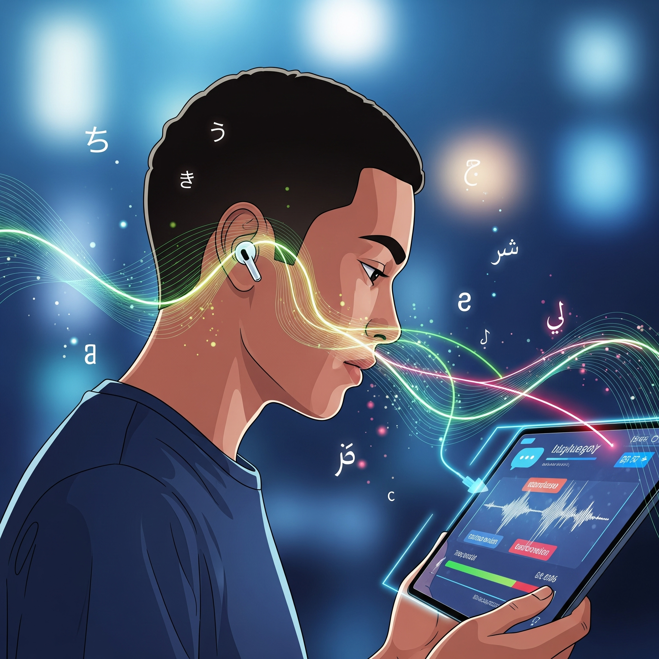
Target Problem Overview
StreamLang is an adaptive language listening platform.
It allows learners to configure a stream tailored to their development.
The problem is difficulty finding content suitable for a learner's level.
Content might be too easy or too hard in vocabulary or grammar.
StreamLang provides customizable vocabulary, grammar, and theme in audio streams.

Slide 4
Project Plan
We separated the project into the following work packages:
Finalization of project scope, features, and technical details. ✅
Completion of UI and interaction designs. ✅
Development of the data scraping algorithm. 🛠️
Design and development of the database. 🛠️

Slide 5
Project Plan
Development of the general backend. 🛠️
Development of the content generation module. ⏳
Development of the content categorization module. ⏳
Development of the streaming module. ⏳
Development of the user interfaces. 🛠️

Slide 6
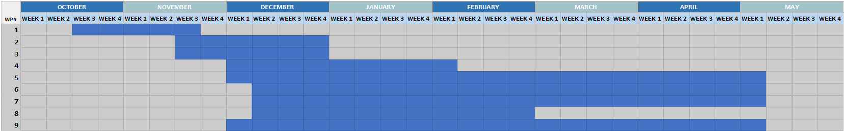
Progress
So far, we have
Decided on requirements, limitations, scope, audience, and tech stack.
Created the project website.
Finished the initial UI drawings.
Started development of frontend.

Slide 7
Current Status
Some of the important decisions we’ve made:
We will initially support English, French, and German.
Users will be able to rewind but won’t be able to go forward.
Alongside choosing between set grammar & vocabulary levels, users will be able to request the stream to include certain words.

Slide 8
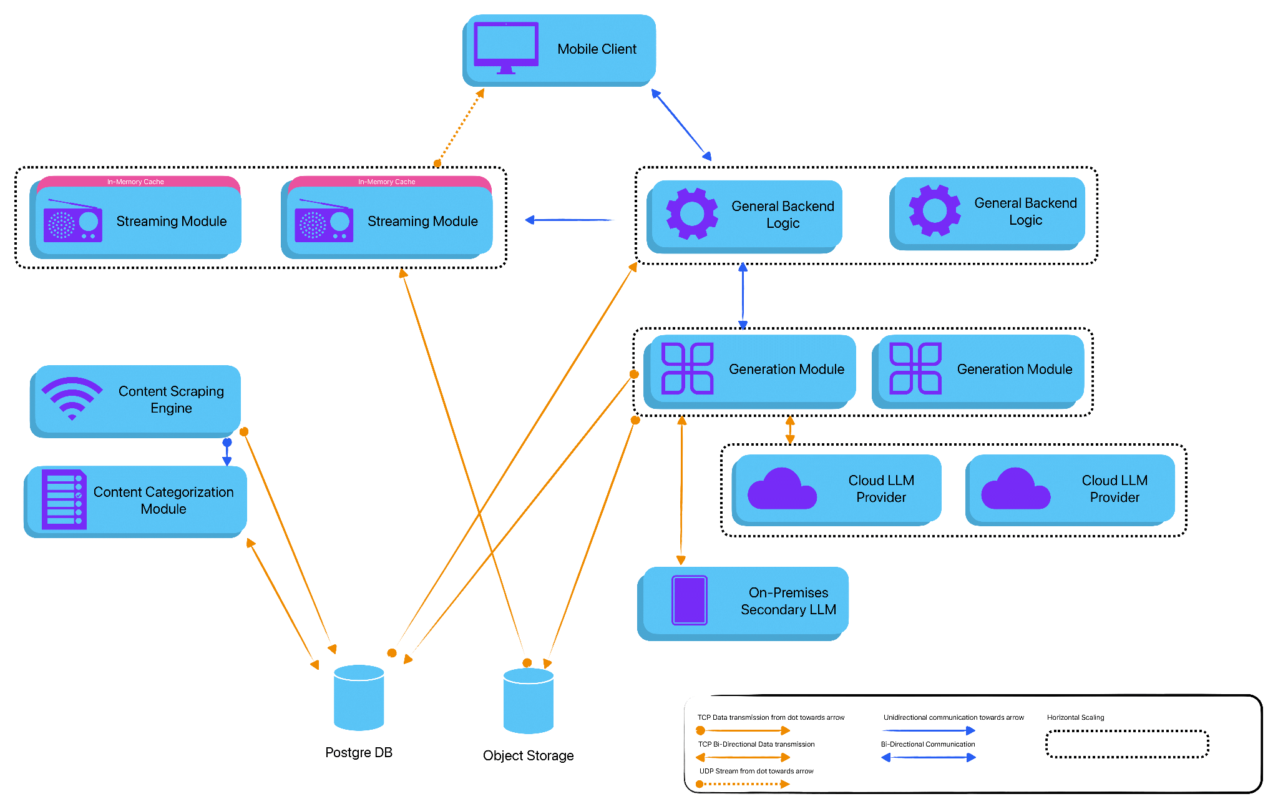
Current Status
Graphical overview
of the architecture:

Slide 9
Thanks for listening.
Moving on to demo.

